Slide 1
http://tinyurl.com/SUTDIEEEWorkshops (Dropbox) => Intro to RPi Series => Part 1 Windows Users: Download & Install MobaXTerm (For SSH) (Or your own choice of SSH Client) Mac Users: Don’t need anything

Slide 2
Intro to RPi (Part 1)
By SUTD IEEE
http://tinyurl.com/SUTDIEEEWorkshops

Slide 3
Agenda
Setting up your RPi
Install Raspbian
Configure Wi-Fi
Set static IP
Setup SSH
Setup VNC
Using the RPi through the Terminal
Using the RPi like an Arduino
GP I/O Pins with Python

Slide 4
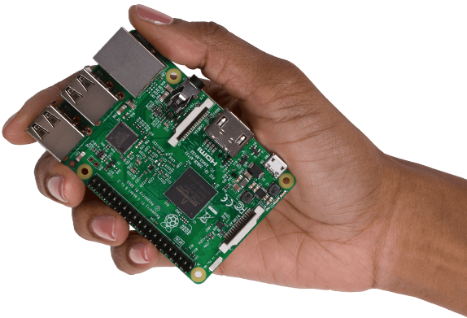
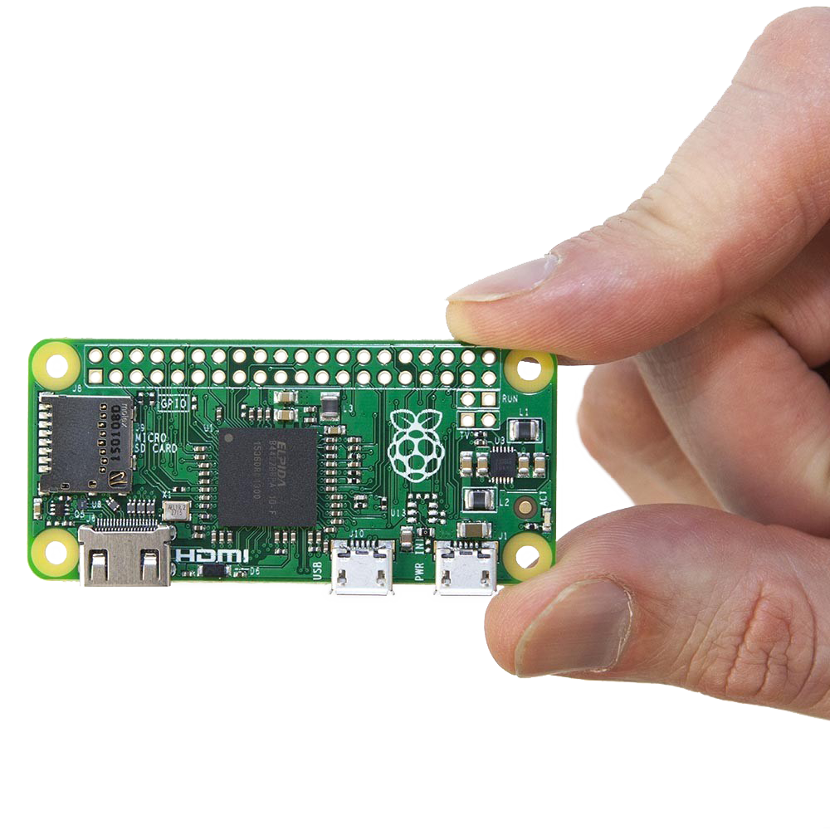
What’s an RPi?!
Single Board Computer
Runs Linux (Most of the time)
Small
System on a Chip (SOC)
All/ most important components are on a single chip (CPU, memory, storage, IO)
Access to GP I/O Pins (Input and Output)
Like an Arduino

Slide 5

Uses of RPi’s
Web Servers
Cloud Servers
Home Automation
Home Security
Arcade Games
Supercomputing (Clusters)
Cryptocurrency mining
Robotics
…

Slide 6
Installing Raspbian on the RPi’s SD Card
Copy Etcher and the Raspbian image to your computer
Connect the microSD Card
Open Etcher
Select the Raspbian image
Click ‘Flash!’

Slide 7
Setting Up Wi-Fi
Raspbian does not have a GUI that supports WPA2 Protocol
Cannot connect to SUTD_Student directly!
Need to configure it manually
Configure network in /etc/wpa_supplicant/wpa_supplicant.conf

Slide 8
Setting Up Wi-Fi
Open Terminal
sudo nano /etc/wpa_supplicant/wpa_supplicant.conf
Add this to the file: network={ ssid=“SUTD_Student” key_mgmt=WPA-EAP eap=PEAP identity=“100XXXX” password=“YOUR_PASSWORD” phase1=“peaplabel=0” phase2=“auth=MSCHAPV2” }
Reboot

Slide 9
Set Static IP Address
What’s an IP(v4) Address?
Why? So we can connect to the RPi at the same address every time.
Open Terminal: ip -4 addr show | grep global ip route | grep default | awk '{print $3}’ cat /etc/resolv.conf

Slide 10
Set Static IP Address
sudo nano /etc/dhcpcd.conf
Add this to the file: interface wlan0 static ip_address=10.1.1.31/24 static routers=10.1.1.1 static domain_name_servers=10.1.1.1
Reboot

Slide 11
What is SSH (Secure Shell)
It is a protocol that allows a computer to remotely log in to another through the Terminal, allowing you to use that computer.
In this case the RPi

Slide 12
Setting up SSH
GUI
Open ‘Applications Menu’ (Top Left) >> ‘Preferences’ >> ‘Raspberry Pi Configuration’
Select the ‘Interfaces’ tab; enable SSH
Command Line
Run: sudo raspi-config
Navigate to interfaces; enable SSH

Slide 13
Setting up VNC (Virtual Network Computing)
RealVNC – Free!
GUI
Open ‘Applications Menu’ (Top Left) >> ‘Preferences’ >> ‘Raspberry Pi Configuration’
Select the ‘Interfaces’ tab; enable VNC
Command Line
Run: sudo raspi-config
Navigate to interfaces; enable VNC

Slide 14
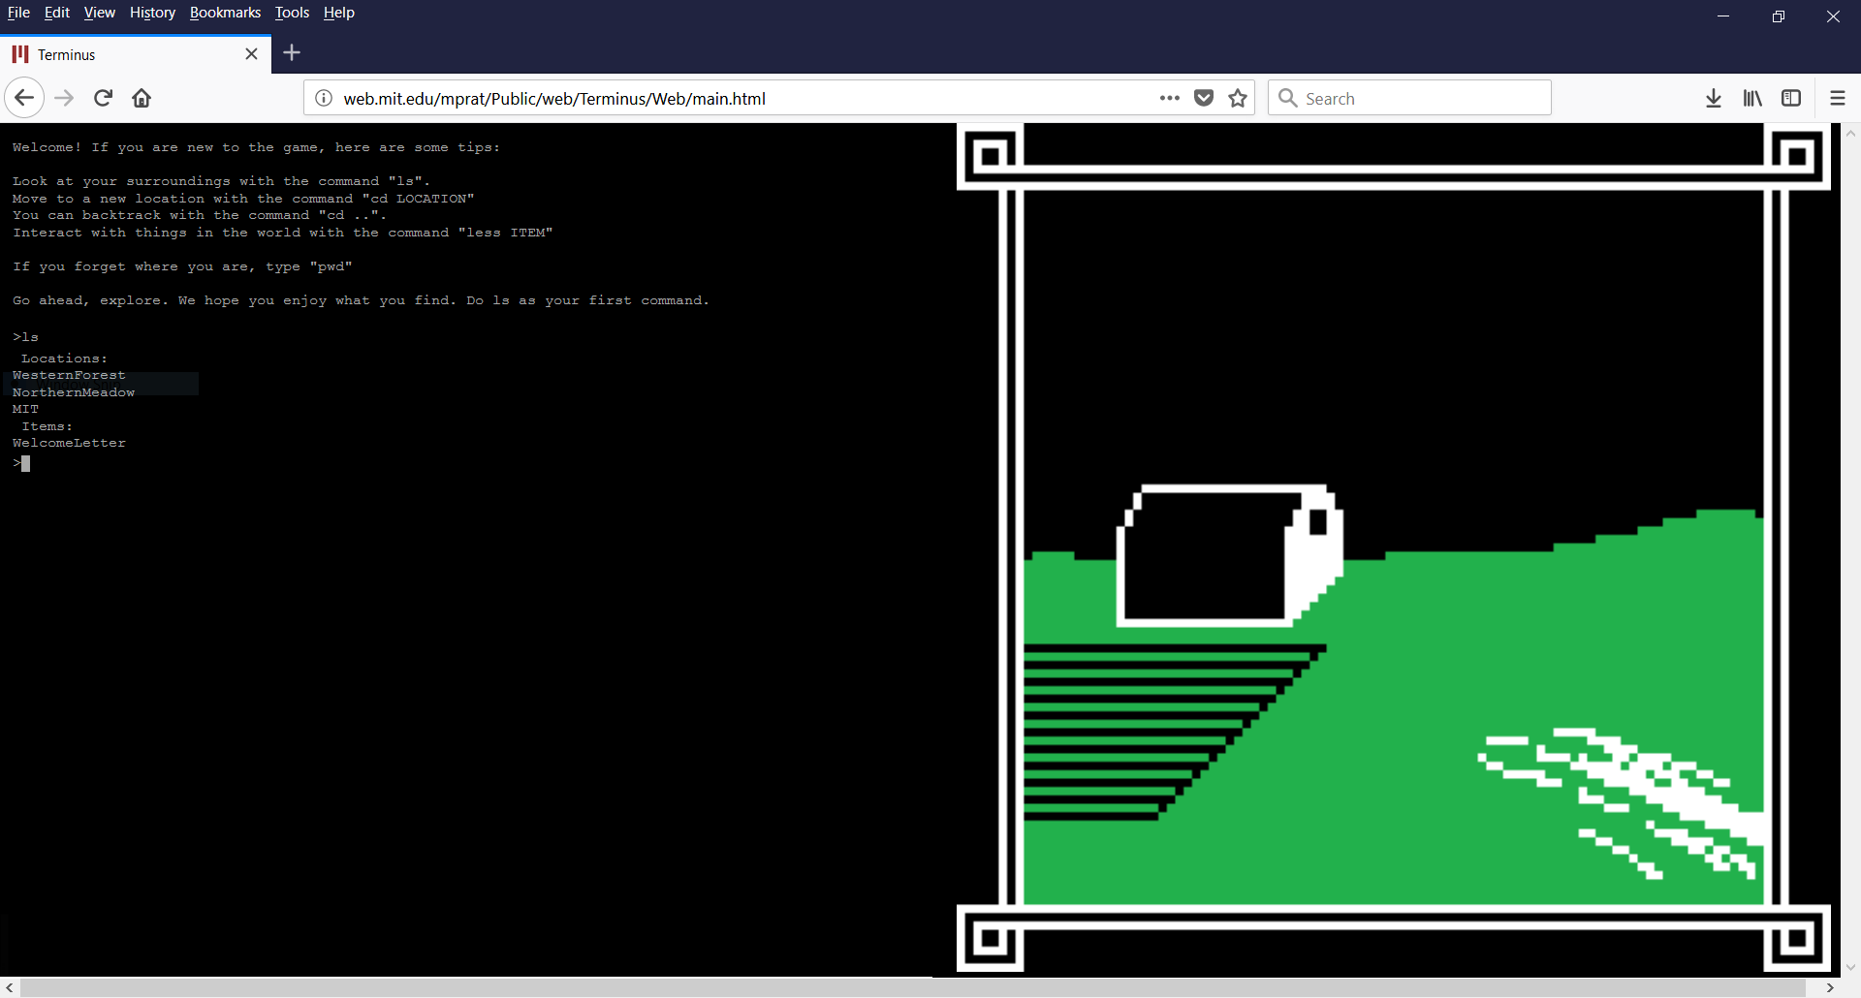
Using the RPi through the Terminal
www.mprat.org/Terminus/
Learn Linux commands to navigate and control the file system.

Slide 15
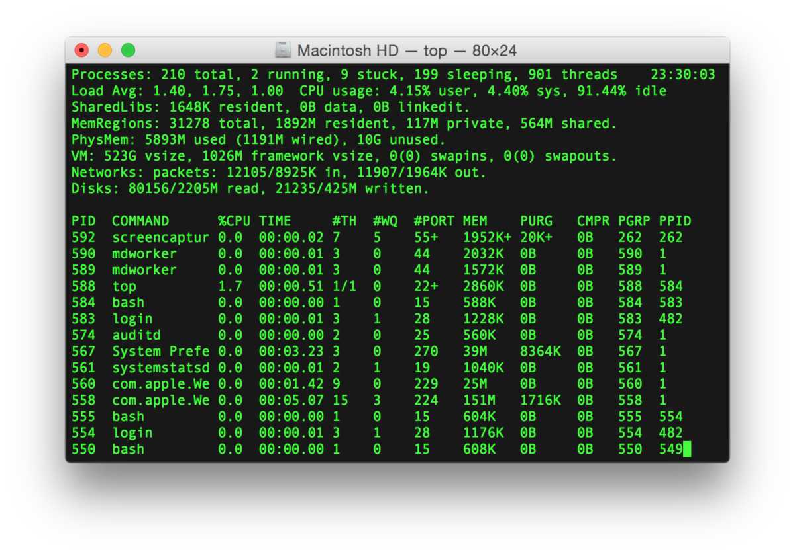
Linux Commands & Tools
cd
ls
touch
rm
mkdir
rmdir
nano/ vi
mv
cp
find
cat
ifconfig
http://www.informit.com/blogs/blog.aspx?uk=The-10-Most-Important-Linux-Commands

Slide 16
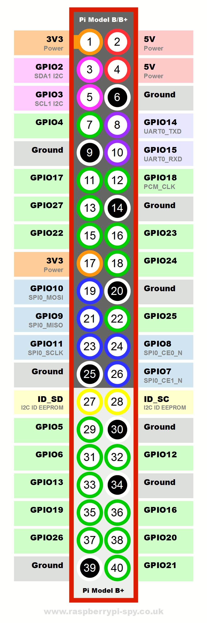
Now for the Electronics Stuff
Program the RPi’s GP I/O Pins
General Purpose Input/ Output
https://pinout.xyz/#
Use it like an Arduino
Can be done using Python, C, C++, NodeJS, Bash, etc.

Slide 17
GP I/O with Python
Install RPI.GPIO (In Terminal)
sudo pip3 install rpi.gpio
In Python File
import RPi.GPIO as GPIO
Documentation
https://sourceforge.net/p/raspberry-gpio-python/wiki/Examples/

Slide 18
GP I/O with Python
GPIO.setmode(MODE) => MODE is GPIO.BOARD or GPIO.BCM
GPIO.setup(channel, GPIO.HIGH) => channel can be a list of channels
GPIO.setup(channel, GPIO.HIGH, initial=GPIO.HIGH)
GPIO.input(channel)
GPIO.output(channel) => channel can be a list of channels
GPIO.PWM(channel,frequency)
GPIO.cleanup()

Slide 19
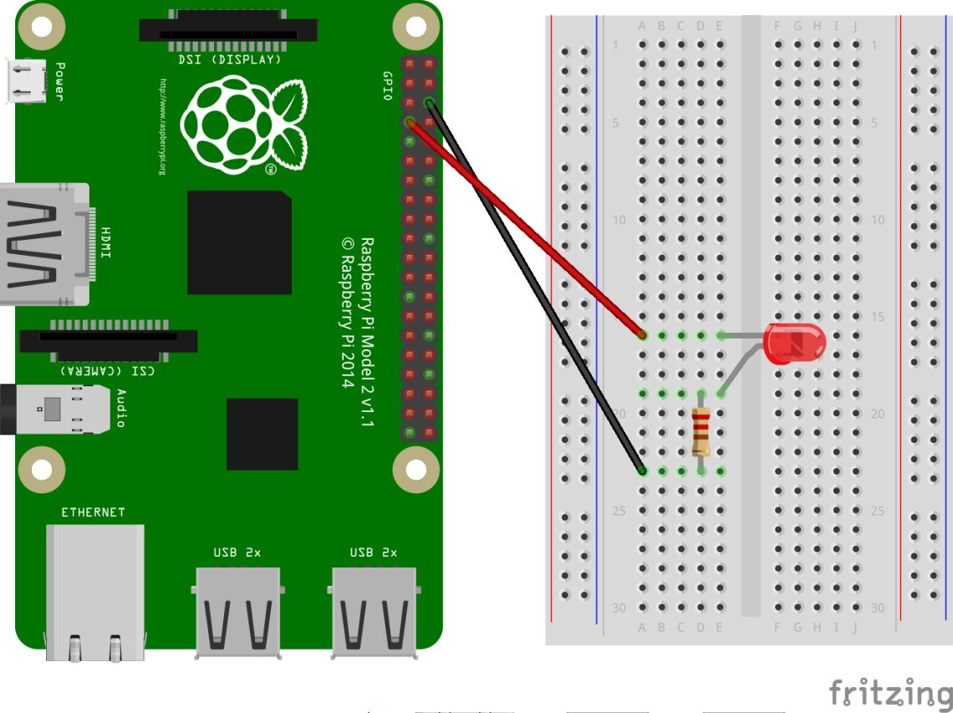
Activity #1: Blinking LED
Connect +ve lead of LED (Longer leg) to BCM26
Refer to https://pinout.xyz/# !
Connect a resistor from the –ve lead of the LED to an empty space
Connect the resistor to a GND pin
Refer to https://pinout.xyz/# !

Slide 20
Activity #1: Blinking LED
import RPi.GPIO as GPIO
from time import sleep
import sys
GPIO.setmode(GPIO.BCM)
GPIO.setup(26,GPIO.OUT)
GPIO.output(26,GPIO.HIGH)
sleep(1) // Sleep for 1s

Slide 21
Activity #1: Blinking LED
Try:
while True:
# Do Something
finally:
GPIO.cleanup()
sys.exit()

Slide 22
Activity #2: Fading LED
Connect +ve lead of LED (Longer leg) to BCM26
Refer to https://pinout.xyz/# !
Connect a resistor from the –ve lead of the LED to an empty space
Connect the resistor to a GND pin
Refer to https://pinout.xyz/# !

Slide 23
Activity #2: Fading LED
pwm = GPIO.PWM(26,1000)
pwm.start(0)
pwm.ChangeDutyCycle(x) // 0 ≤ x ≤ 100
for i in range(100):
pwm.stop()

Slide 24
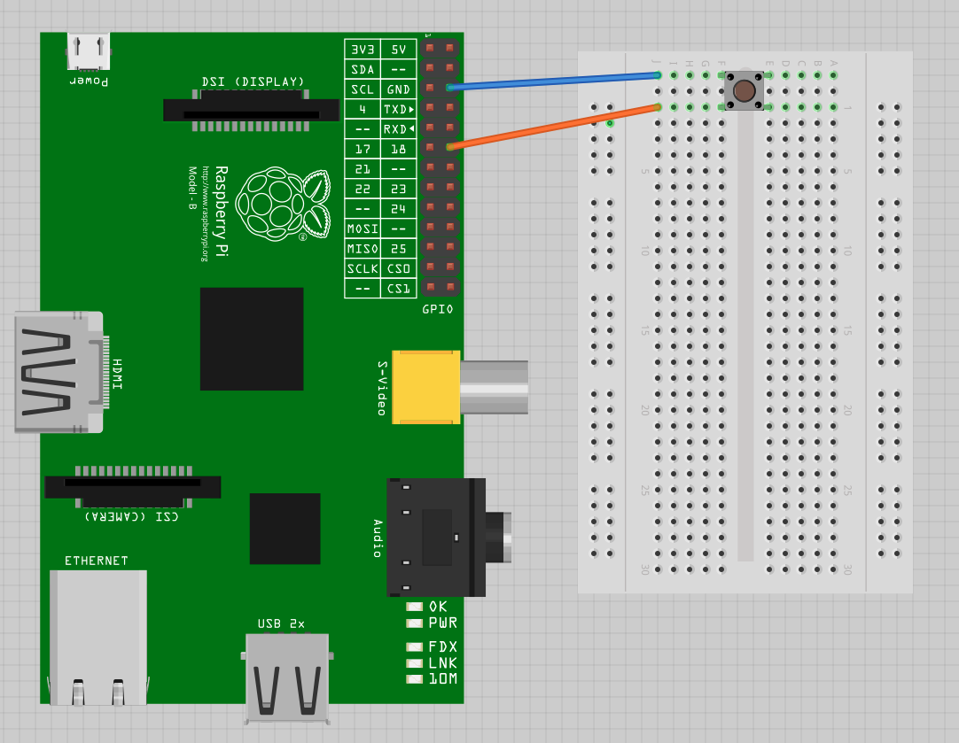
Activity #3: Push Button
Connect one end of the button to BCM26
Connect the other end on the same side to GND

Slide 25
Activity #3: Push Button
GPIO.setup(26,GPIO.IN,pull_up_down=GPIO.PUD_UP)
GPIO.add_event_detect(channel, GPIO.FALLING)
if GPIO.event_detected(channel): #Do Something

Slide 26
Activity #3: Push Button - Debounce
Oscillation in mechanical switch in button => Multiple button presses
Logic:
Wait for x ms after button pressed and until button is released
Only then register it as 1 button press

Slide 27
Activity #3.1: TRY It Yourself
Use a push button to toggle an LED on and off!
Press button => LED turns on & remains on
Press button again => LED turns off & remains off
TRY!
Hint: You are going to need to keep track of the state of the LED (is it current on/ off)
Syntax
if (SOME STATEMENT): # Do Something

Slide 28
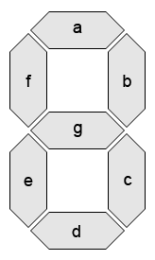
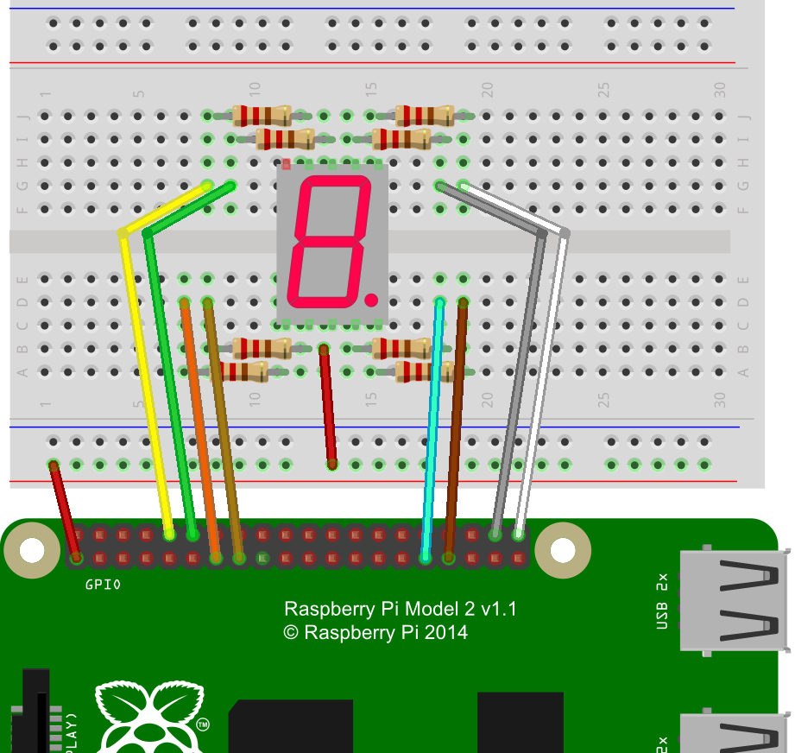
Activity #4: 7-Segment Driver
Choose 7 I/O Pins on the Raspberry Pi
Connect 7 resistors to the 7-Segment display
Connect wires
Code is the same as controlling an LED, just 7 of them!

Slide 29
Activity #4: 7-Segment Driver
Creating a function in Python:
def my_function(param1, param2): ## Your function goes here
Getting user input:
my_input = input(“Write something: ”)

Slide 30
Serial Communication
Send data bit by bit, instead of all at once
Many protocols:
UART / USART
SPI
I2C
…

Slide 31
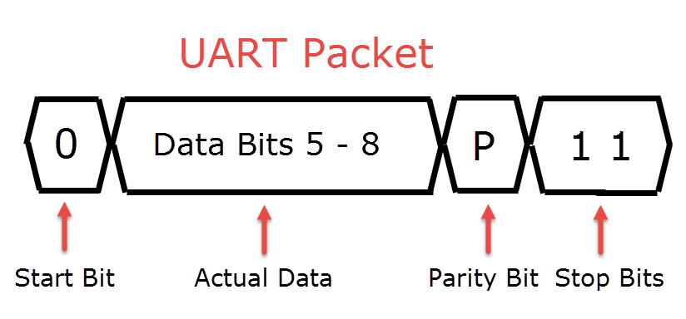
Serial Communication (UART)
Universal Asynchronous Receiver-Transmitter
Star-Bit
Data Bits
Parity Bit (Optional)
Stop Bit/s

Slide 32
Python Serial in RPI (With Arduino)
Why?
Offload processing and simple tasks to Arduino
Add more input/ output pins
Connect to other serial peripherals
How?
Connect a USB cable from the Pi to the Arduino

Slide 33
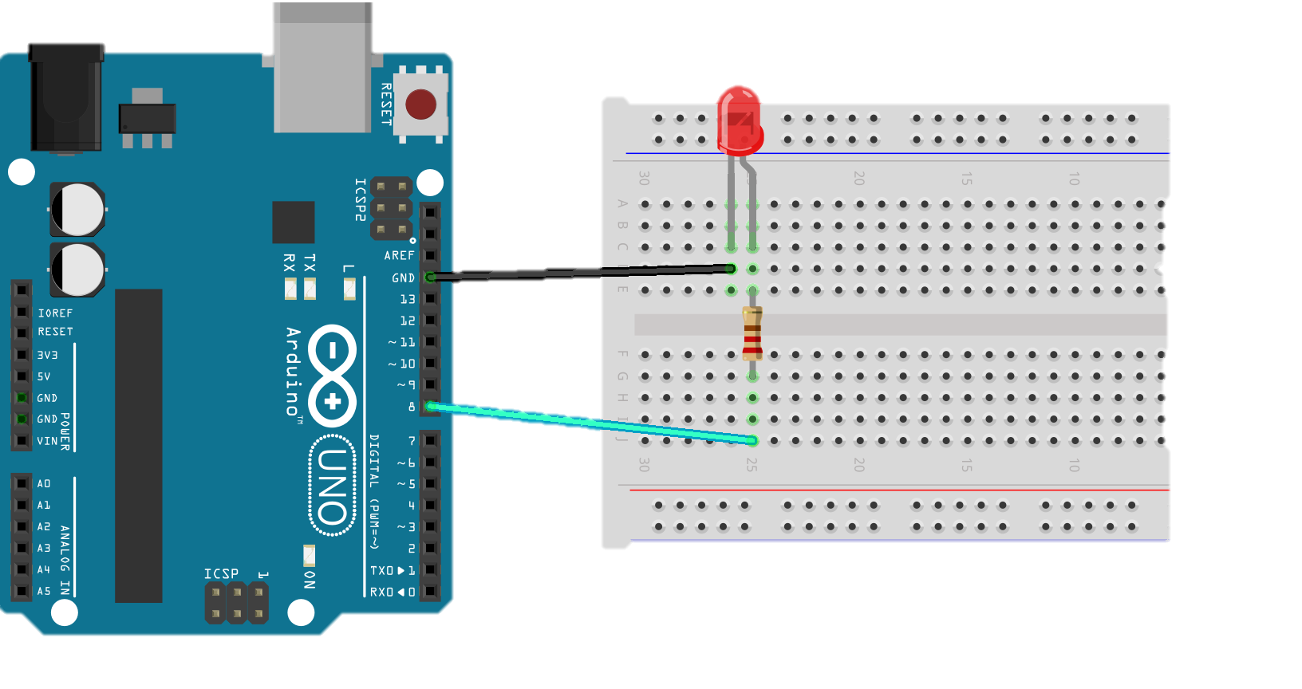
On Arduino
String inString = “”; void serialEvent() { char c = ‘ ’; c = Serial.read(); if (c == ‘\n’) { // Do something inString = “”; } else { inString += c; } }

Slide 34
SPI and I2C
RPi has:
3 SPI Bus’s (Only one accessible via the headers)
2 I2C Bus’s accessible through the headers
I think

Slide 35
The ENd

